Slide 1
16.216
ECE Application Programming
Instructor: Dr. Michael Geiger
Fall 2013
Lecture 32:
Dynamic memory allocation

Slide 2
Lecture outline
Announcements/reminders
  Program 9 due 12/2
  Program 10 to be posted; due 12/11
  No class 11/27
Today’s class
  Dynamic memory allocation
ECE Application Programming: Lecture 32

Slide 3
Review: dynamic memory allocation
Basic block allocation:
void *malloc(size_t size);
Allocate block and clear it:
void *calloc(size_t nmemb,
size_t size);
Resize previously allocated block:
void *realloc(void *ptr,
size_t size);
Deallocation function:
void free(void *ptr);
ECE Application Programming: Lecture 32

Slide 4
Basic allocation with malloc()
void *malloc(size_t size);
Allocates size bytes; returns pointer
  Returns NULL if unsuccessful
Example:
int *p;
p = malloc(10000);
if (p == NULL) {
/* Allocation failed */
}
ECE Application Programming: Lecture 31

Slide 5
Type casting
All allocation functions return void *
Automatically type cast to appropriate type
Can explicitly perform type cast:
int *p;
p = (int *)malloc(10000);
Some IDEs (including Visual Studio) strictly require type cast
ECE Application Programming: Lecture 31

Slide 6
Allocating/clearing memory: calloc()
void *calloc(size_t nmemb,
size_t size);
Allocates (nmemb * size) bytes
Sets all bits in range to 0
Returns pointer (NULL if unsuccessful)
Example: integer array with n values
int *p;
p = (int *)calloc(n, sizeof(int));
ECE Application Programming: Lecture 31

Slide 7
Resizing allocated space: realloc()
void *realloc(void *ptr,
size_t size);
ptr must point to previously allocated space
Will allocate size bytes and return pointer
  size = new block size
Rules:
  If block expanded, new bytes aren’t initialized
  If block can’t be expanded, returns NULL; original block unchanged
  If ptr == NULL, behaves like malloc()
  If size == 0, will free (deallocate) space
Example: expanding array from previous slide
p = (int *)realloc(p,
(n+1)*sizeof(int));
ECE Application Programming: Lecture 31

Slide 8
Deallocating memory: free()
All dynamically allocated memory should be deallocated when you are done using it
  Returns memory to list of free storage
  Once freed, program should not use location
Deallocation function:
void free(void *ptr);
Example:
int *p;
p = (int *)malloc(10000);
...
free(p);
ECE Application Programming: Lecture 31

Slide 9
Review: dynamically allocated arrays
One common use of dynamic allocation: arrays
Can determine array size, then create space
  Use sizeof() to get # bytes per element
Array notation can be used with pointers
int i, n;
int *arr;
printf("Enter n: ");
scanf("%d", &n);
arr = (int *)malloc(n * sizeof(int));
for (i = 0; i < n; i++)
arr[i] = i;
ECE Application Programming: Lecture 32

Slide 10
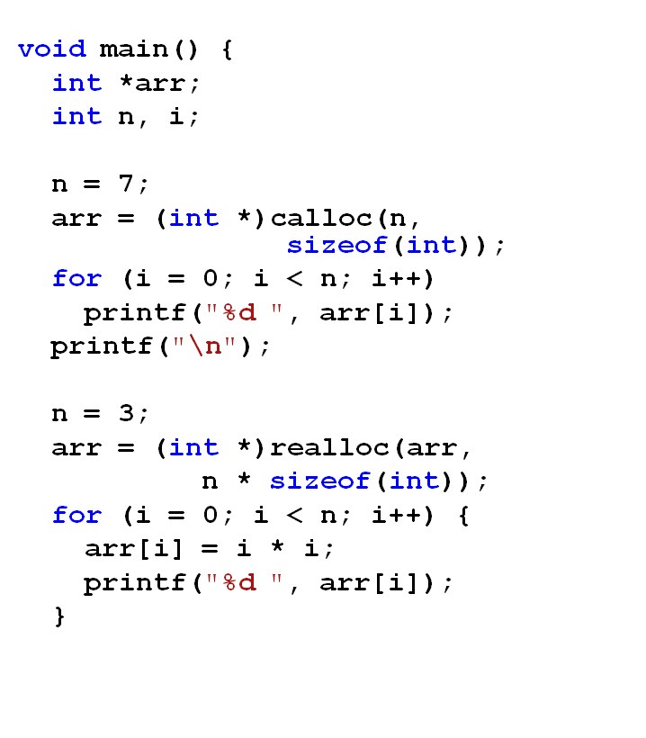
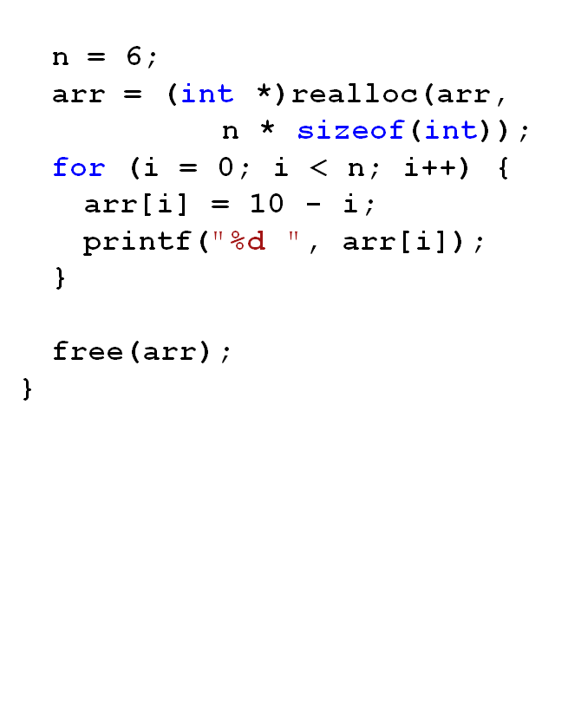
Example: what does program print?
ECE Application Programming: Lecture 31

Slide 11
Solution
Output:
0 0 0 0 0 0 0
0 1 4 10 9 8 7 6 5
ECE Application Programming: Lecture 31

Slide 12
Pitfalls: memory leaks
Changing pointers leaves inaccessible blocks
Example:
p = malloc(1000);
q = malloc(1000);
p = q;
Block originally accessed by p is “garbage”
  Won’t be deallocated—wasted space
Solution: free memory before changing pointer
p = malloc(1000);
q = malloc(1000);
free(p);
p = q;
ECE Application Programming: Lecture 32

Slide 13
Pitfalls: dangling pointers
free() doesn’t change pointer
  Only returns space to free list
Pointer is left “dangling”
  Holds address that shouldn’t be accessed
Solution: assign new value to pointer
  Could reassign immediately (as in previous slide)
  Otherwise, set to NULL
  free(p);
  p = NULL;
ECE Application Programming: Lecture 32

Slide 14
Dynamically allocated strings
Strings → arrays of characters
Basic allocation: based on string length
  sizeof(char) is always 1
  Need to account for null character
Example: copying from s to str
  char *str = (char *)malloc(strlen(s) + 1);
  strcpy(str, s);
Note: dynamically allocated strings must be deallocated when you are done with them
ECE Application Programming: Lecture 32

Slide 15
Dynamically allocated 2D arrays
Think of each row as 1D array
  2D array: an array of 1D arrays
Since array is technically a pointer, 2D array can be implemented as array of pointers
  Data type: “pointer to pointer”
    Example: int **twoDarr;
  1st dimension depends on # rows
    twoDarr = (int **)malloc(nRows * sizeof(int *));
  2nd dimension depends on # columns
    Must allocate for each row
    for (i = 0; i < nRows; i++)
    twoDarr[i] = (int *)malloc(nCols * sizeof(int));
ECE Application Programming: Lecture 32

Slide 16
Example
Complete each of the following functions
  char *readLine(): Read a line of data from the standard input, store that data in a dynamically allocated string, and return the string (as a char *)
    Hint: Read the data one character at a time and repeatedly reallocate space in the string
  int **make2DArray(int total, int nR): Given the total number of values and number of rows to be stored in a two-dimensional array, determine the appropriate number of columns, allocate the array, and return its starting address
    Note: if nR does not divide evenly into total, round up. In other words, an array with 30 values and 4 rows should have 8 columns, even though 30 / 4 = 7.5
ECE Application Programming: Lecture 32

Slide 17
Solution
char *readLine() {
char c; // Input character
char *str = NULL; // String to hold line
int n = 1; // Length of str
// Repeatedly store character in str until
// '\n' is read; resize str to hold char
while ((c = getchar()) != '\n') {
str = (char *)realloc(str, n+1);
str[n-1] = c;
n++;
}
str[n-1] = '\0'; // Null terminator
return str;
}
ECE Application Programming: Lecture 32

Slide 18
Solution (continued)
int **make2DArray(int total, int nR) {
int **arr; // 2-D array
int nCols; // # of columns
int i; // Row index
// Calculate nCols; round up if nR does not divide evenly
nCols = total / nR;
if ((total % nR) != 0)
nCols++;
// Allocate array--first array of rows, then each row
arr = (int **)malloc(nR * sizeof(int *));
for (i = 0; i < nR; i++)
arr[i] = (int *)malloc(nCols * sizeof(int));
return arr;
}
ECE Application Programming: Lecture 32

Slide 19
Next time
Dynamically allocated data structures
Reminders:
  Program 9 due 12/2
  Program 10 to be posted; due 12/11
  No class 11/27
ECE Application Programming: Lecture 32

